Slide 1
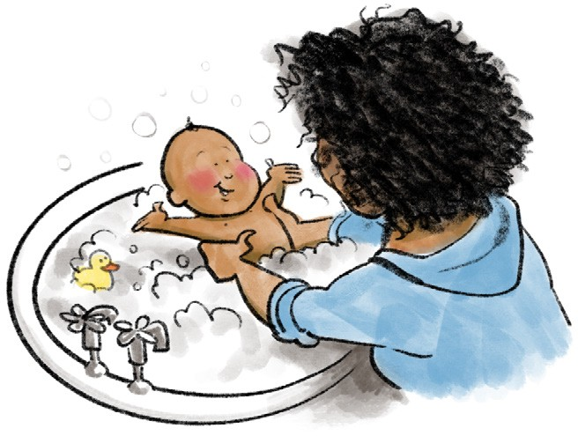
You are invited to
BABIES MATTER
A free group starting in your local area coming together with food to think about all the changes, challenges and joys of having a baby.
During the 6 weeks, we cover the following:
Session 1 – Changes for me and us
Session 2 – Bonding and Attachment
Session 3 – Helping baby to develop
Session 4 – Building strong relationships Session 5 – Baby’s amazing brain
Session 6 – Thinking back, looking forwards
kidsmatter.org.uk Registered charity no. 1163617

Slide 2
You are invited to
BABIES MATTER
A free group starting in your local area coming together with food to think about all the changes, challenges and joys of having a baby.
Parents get together
At:
On:
Time:
Contact:

