Slide 1
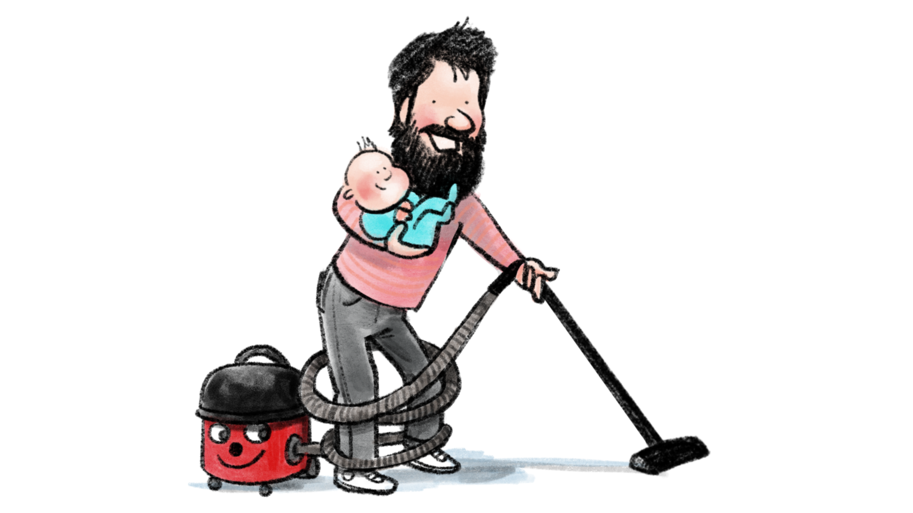
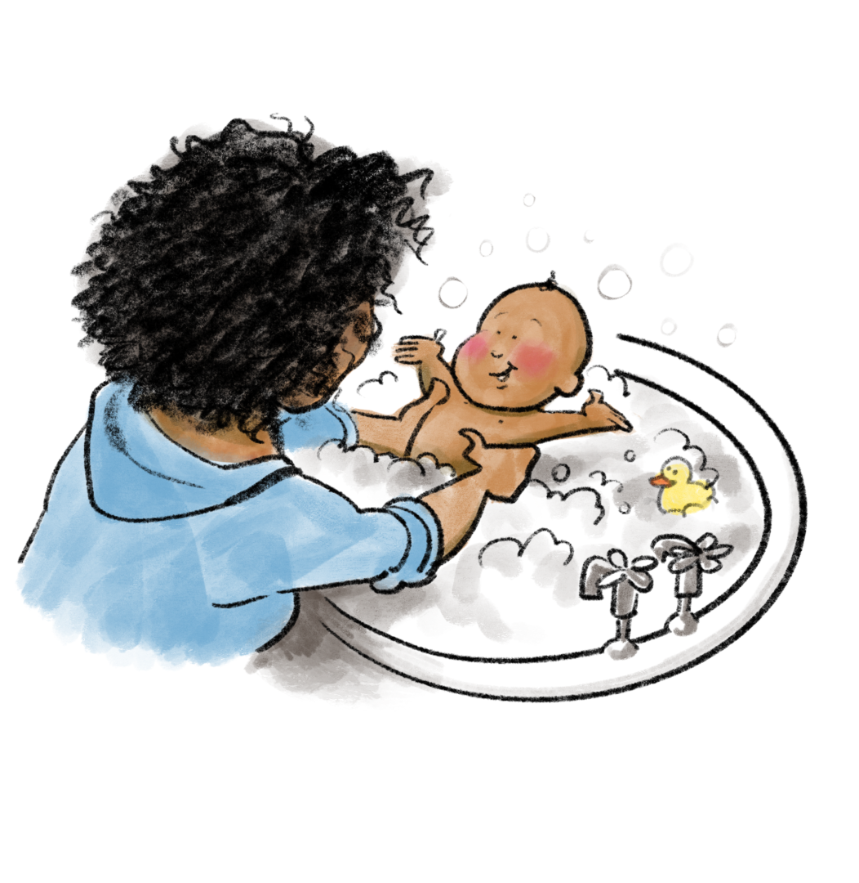
Supporting new and expectant parents in building a strong relationship with your baby.
6 week programme starting soon in your area
Contact XXXXX
on XXXX

Slide 2
Supporting new and expectant parents in building a strong relationship with your baby.
6 week programme starting soon in your area
Contact XXXXX
on XXXX

