Slide 1
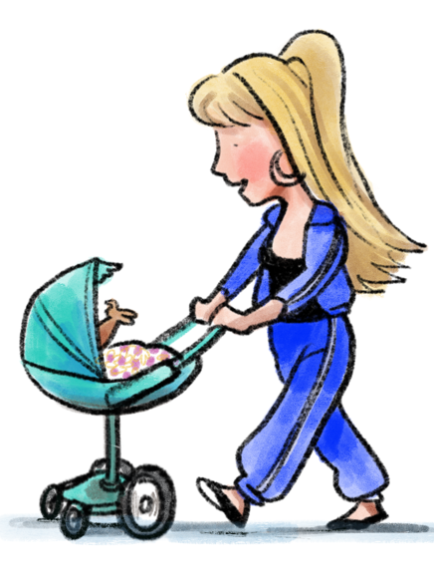
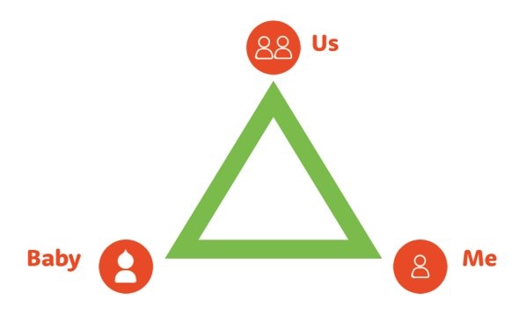
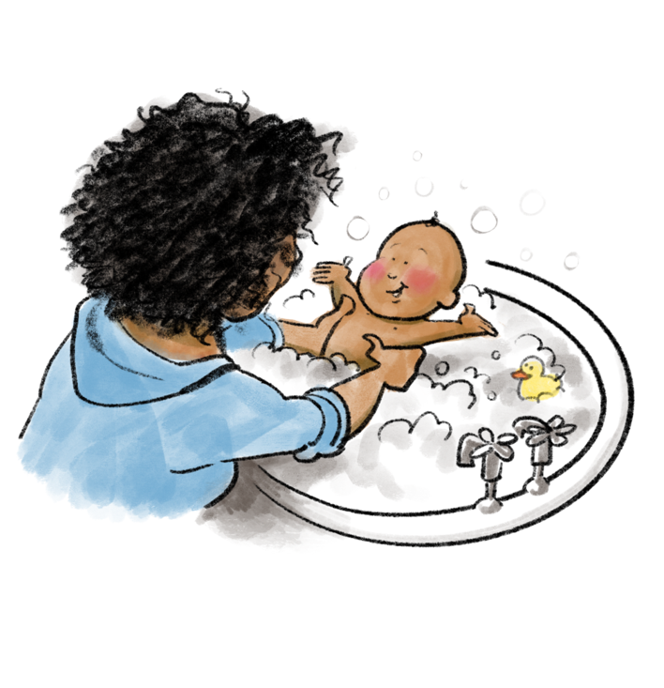
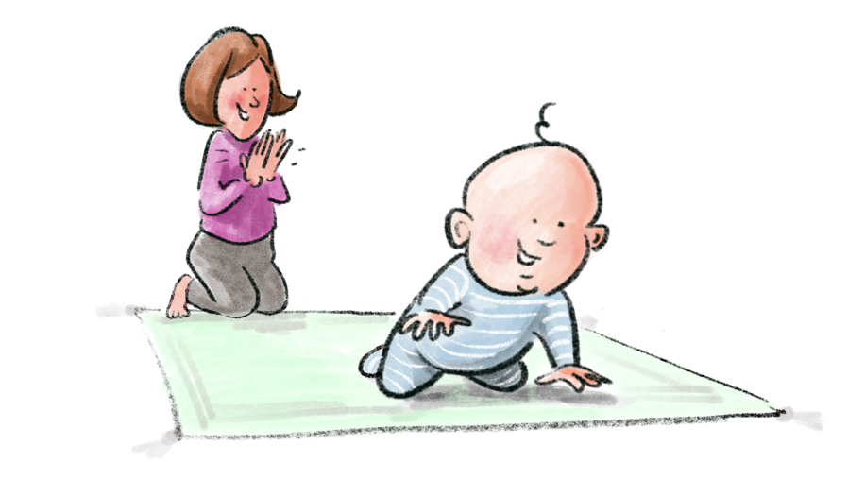
REFERRAL DETAILS
What is Babies Matter?
Babies Matter is a programme to support both expectant parents and those with new babies who are facing disadvantage. The programme helps parents to lay strong foundations for their relationship with their child through 6 group sessions led by a trained peer-facilitator.
Why is Babies Matter needed?
The transition to parenthood can be a stressful time and for those facing additional challenges in life such as mental illness or trauma, poverty, or single parenting, this can be especially difficult. These circumstances can impact an individual’s mental health as well as put additional strain on the parenting relationship*.
Babies Matter aims to help parents build a strong attachment with their child focusing on their understanding of their baby as well as looking after their own mental wellbeing. The programme also actively focuses on strengthening the ‘parenting team’; investing in these three areas of family life (‘baby’, ‘me’, and ‘us’) gives parents the tools to raise their baby in a strong family.
*By relationships we mean co-parents, new partners, single parents with their support bubble. Invitations and referrals from professionals are one of the best ways of ensuring that the programme is accessible for the families who would most benefit from this input.
Please turn over for details on how to refer to your local programme.

Slide 2
REFERRAL DETAILS
Who is the programme for?
The programme is tailored for parents who are facing disadvantage and places are limited to those who would most benefit from this support. Parents attending the group must meet / have at least one of the essential criteria:
Essential Criteria | Supporting Criteria
Social housing | Single parent
On benefits | Unemployed
Refugee | Isolation
Low educational attainment | Mild mental health difficulties (GAD7 or PHQ9 carried out)
Concerns raised by social services or key worker (GP, Midwife, Health Visitor etc) | Vulnerable
Court involvement | Bereaved
Known to social services | Functioning alcoholic/narcotics
Care leaver | ESOL (English for Speakers of Other Languages)
Homeless | Domestic violence
Offender / ex-offender | Relative in prison
 | Teenage mum
We welcome parents-to-be from their 20-week scan onwards and no later than their baby turning 1 years old. The ideal scenario is for both parents to attend; single parents are encouraged to bring with them an adult who will support them in their parenting journey.
Please consider carefully before referring those with severe mental health difficulties or serious drug / alcohol dependency as signposting to other services may be more beneficial.
To make a referral contact:
What to do if you are working with a family who doesn’t meet these criteria but who you think would benefit from attending?
We understand that there will be certain cases where these criteria exclude parents who would benefit from attending Babies Matter. These parameters are in place to help health professionals understand who will get the most from programme and the way it has been designed. However, please do contact us if you would like to further discuss a referral that stands out to you, and we’d love to work out together what the best route is.
Thank you again for your time. We’re delighted to be working with you to support parents and babies in the community.

