Slide 1
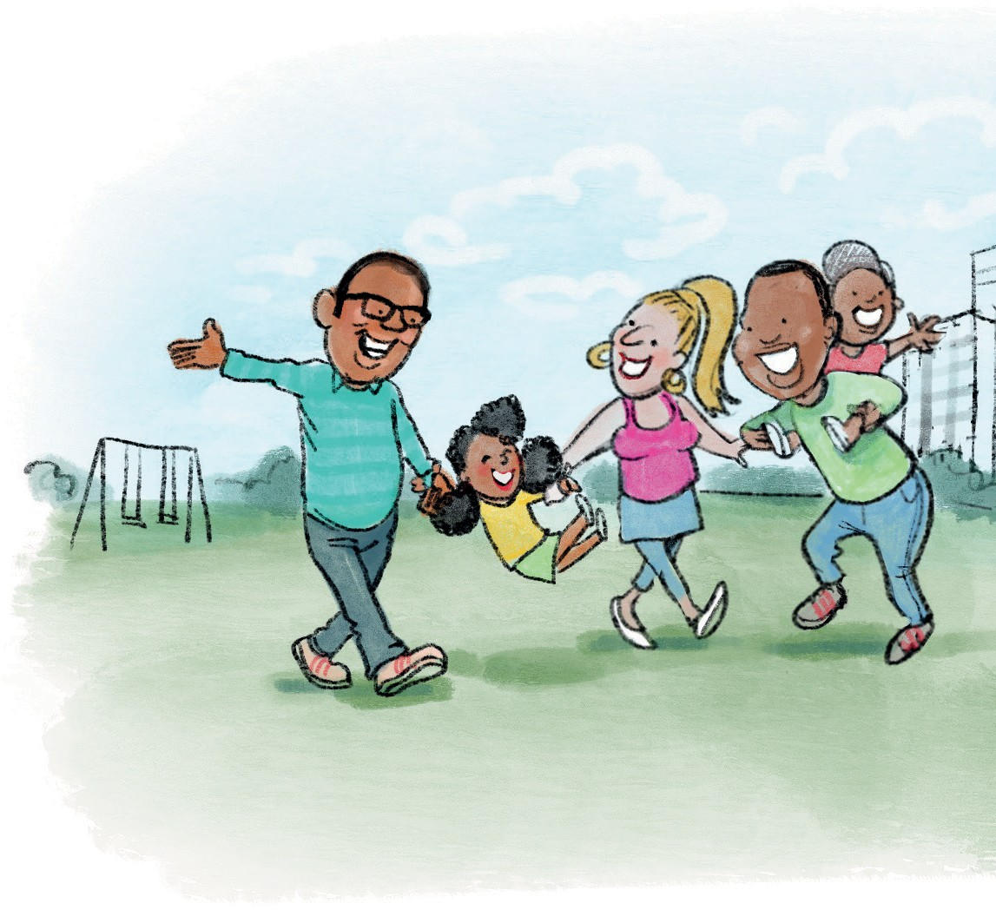
You are invited to
KIDS MATTER
A group for anyone caring for kids between 1-10 yrs old. A chance to talk with others over coffee, tea and food.
During the 6 weeks, we cover the following:
Taster session – Come and see what it’s like to be in a Kids Matter group
Session 1 – Building a strong family
Session 2 – Loving our children well
Session 3 – Play, encouragement and listening
Session 4 – Routines and rewards
Session 5 – Family rules and consequences
Session 6 – The bigger picture
Booster session – Checking in 3 months later
Free Crèche available.

Slide 2
You are invited to
KIDS MATTER
A group for anyone caring for kids between 1-10 years old. A chance to talk with others over coffee, tea and food. Free crèche available.
Do join us!
Parents get together
At:
On: Time: Contact:
REGISTERED CHARITY IN ENGLAND AND WALES 1163617

