Slide 1
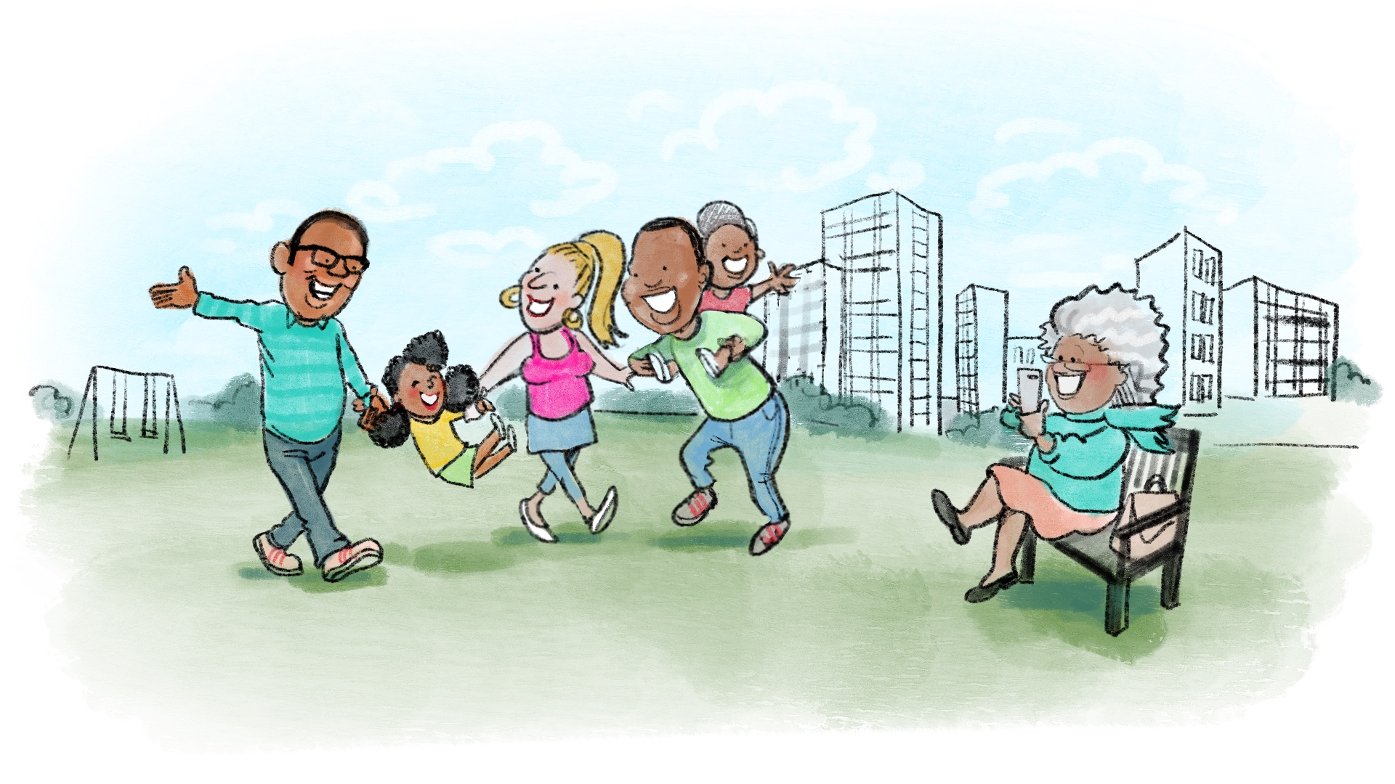
Kids Matter is a free,
friendly group for anyone with children aged 1-10 years.
6 week programme starting soon in your area
Contact XXXXX
on XXXX

Slide 2
Kids Matter is a free,
friendly group for anyone with children aged 1-10 years.
6 week programme starting soon in your area
Contact XXXXX
on XXXX

